Slide 1
New Visions Health 2022 Senior Year Option Explore a Healthcare Careers Earn College Credits Shadow alongside Professionals in the Field

Slide 2
Welcome to Orientation 2022
Objectives
Discuss Expectations
Discuss Courses
Discuss Hospital Rotations
Summer Work Requirements
Medical Requirements
Answer any and all questions

Slide 3
New Visions Model
New Visions is a New York State approved curriculum
Purpose is to provide H.S. Seniors an opportunity to explore a specific career
Students learn knowledge related to their field in classroom setting
Students do Rotations with people working in the field and gain real world experience
Field trips and speakers provide more knowledge about careers and opportunities
https://pnwboces.org/Tech/Courses/New-Visions-Health

Slide 4
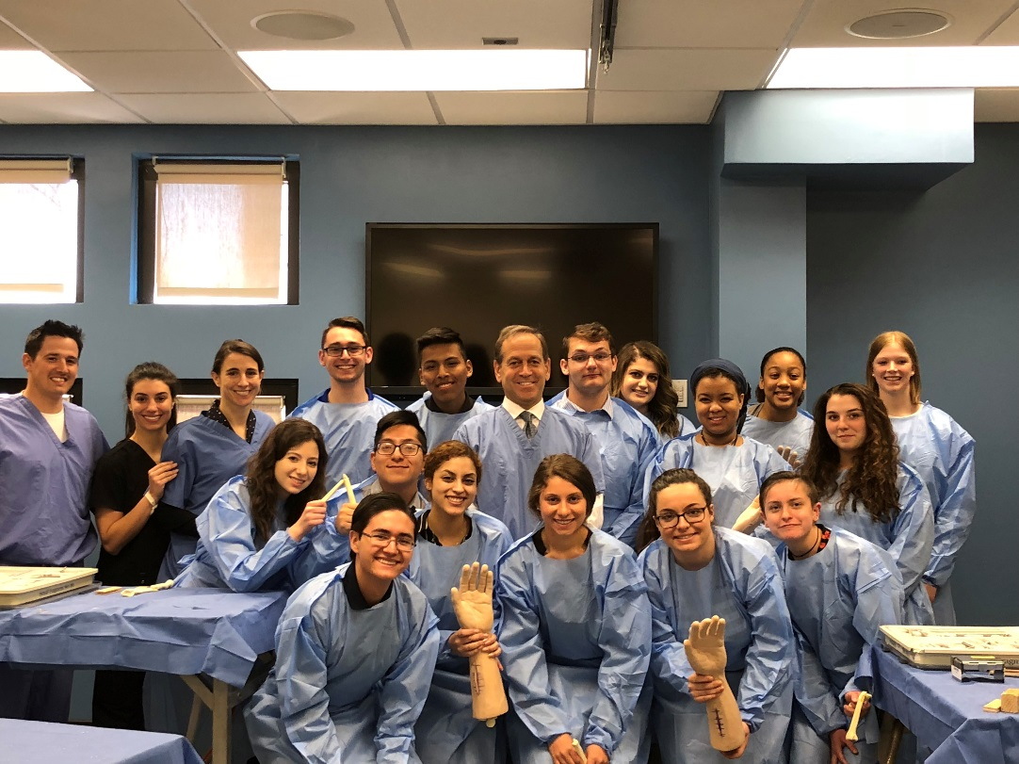
New Visions
Prepares you for transition to college
Looked on favorably by colleges for admissions
Earn college credit (12 credits possible)

Slide 5
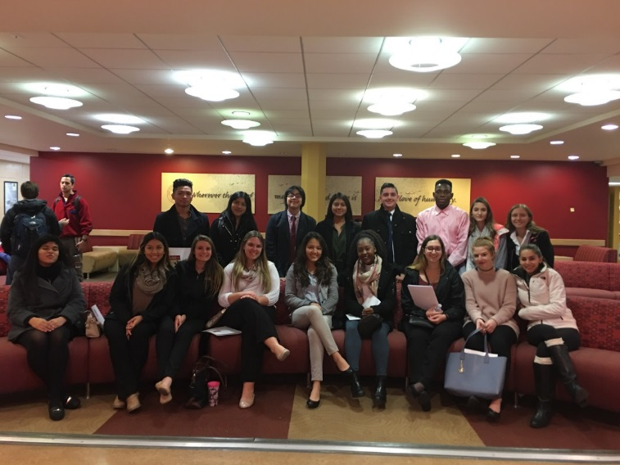
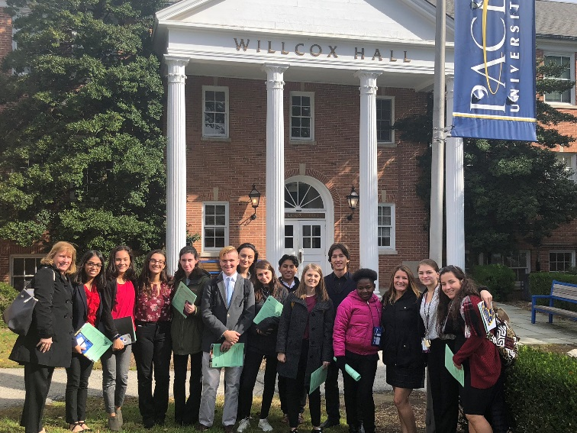
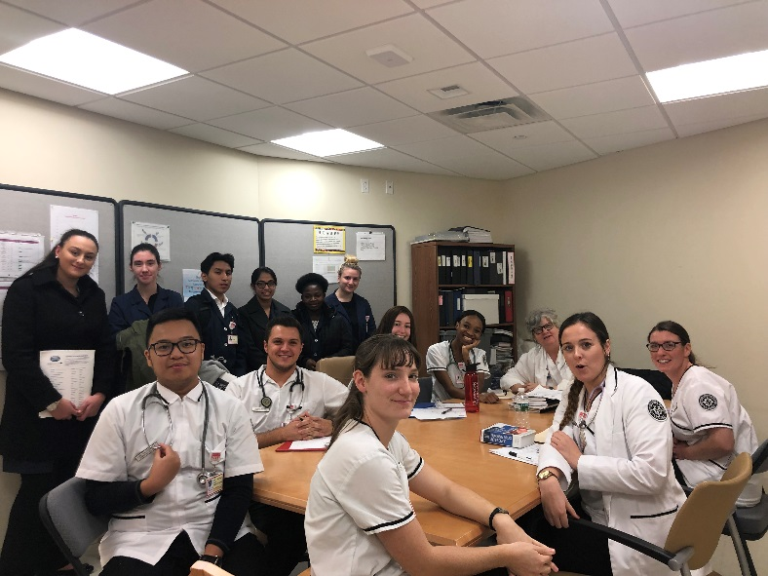
What is New Visions?
Study advanced curriculum
Field Trips
Guest Speakers
Presentations and Projects
Internships

Slide 6
Careers in the Health Field
Registered Nurse
Medical Doctor
Physical Therapist
Occupational Therapist
Pharmacist
Dietician
Nurse Practitioner
Radiologist
Laboratory technologist
Surgeon
Hospital Administration
Hospitalist
Physicians Assistant

Slide 7
Class Information
4 hours each day in classroom 8-12
Clinical sites 8-11:30 am
Clinical rotations at hospitals
Student Exit Project on Medical Ethic issue
The pros and cons of the medical ethical issue
5 pages with a Power Point presented to the class
Senior year physical education
Monthly Objectives
Rotation Objectives

Slide 8
Curriculum materials
Textbooks
Memmler’s Structure and Function
Simmers Diversified Health Occupations
Chabner The Language of Medicine
Schoolwires Website https://ny24000991.schoolwires.net/Page/701

Slide 9
Grading Policy
Structure and Function & Diversified Health Objectives 25%
Medical Terminology Calculated through WCC
Projects 25% Exit Project in June 60%
Monthly Objectives/Hospital Rotation Objectives 25%
Attitudinal (Absences, Tardiness, Active Participation)/ Portfolios (Accumulated Organized Work Binders) 25%

Slide 10
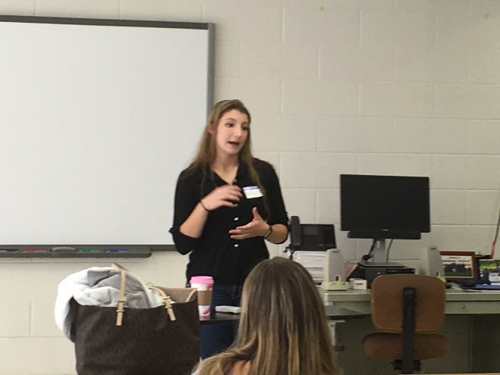
New Visions Health
Structure and Function
Diversified Health Occupations
Medical Terminology
New York Medical College
Guest Speakers
Field Trips
Presentations and Projects

Slide 11
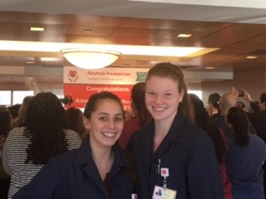
College Credits
SUNY WCC English is:
English 101 - Writing and Research (3 credits)
English 102 - Writing and Literature (3 credits)
Mercy College
Political Science 101 (POLSCI 101) (3 credits)
SUNY WCC Medical Terminology
NHSCI 101 - Medical Terminology (3 credits)

Slide 12
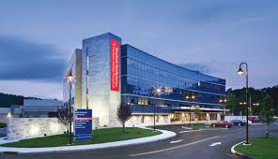
Hospital Rotations

Slide 13
Work with Hospital Professionals

Slide 14
Rotation Sites
Emergency Room
Ambulatory Surgery
Physical Therapy
Pharmacy
Nursing 2 South
Respiratory Therapy
Radiology CT scan/ Core
Wound Care
Dietary
Pinesbridge School
Maternity
Nursery
OR/PACU
ICU/PCU
Infusion/ Radiation Center
Hospitalist
Nuclear Medicine/ Cardiac Rehab
Laboratory
North Westchester Restorative

Slide 15
program Advantages
Learn if the career is the right field to study in college
Small class size-- teacher attention, study your interests in depth
Prepare you for college
Obtain 12 college credits
Learn how to do health, or scientific related research
Work in the field of your choice

Slide 16
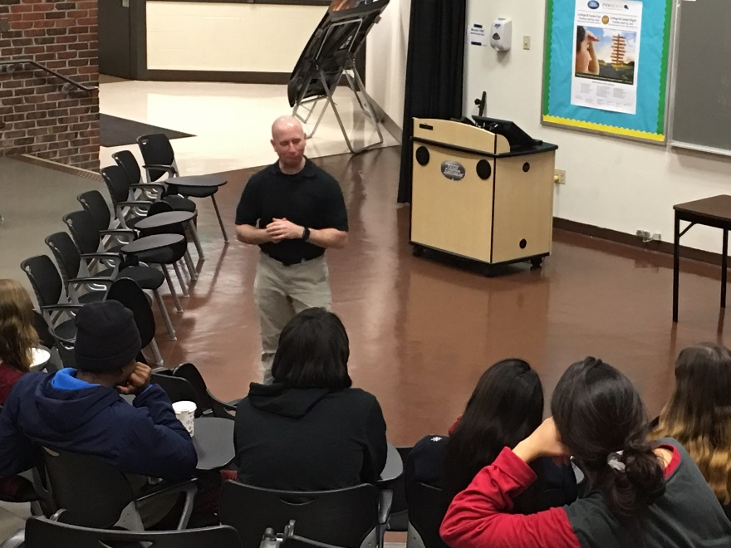
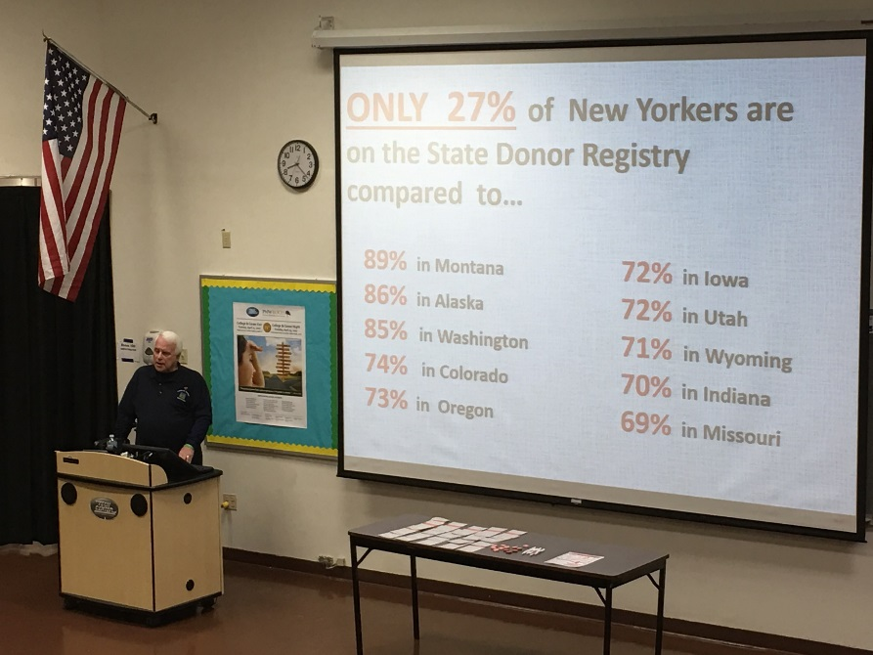
How to Enroll
Students who have an 85% or better from home school, depending on the program
2 letters of recommendation
Interview by New Visions Panel
Writing sample

Slide 17
Summer Requirements
Certified in CPR BLS by September of their senior year
The Completed Physical Form handed in for September
including Flu Vaccine,
PPD for Tuberculosis Surveillance
Urine Toxicology
COVID Vaccine
English Assignment to be complete over the summer
Social Studies Assignment to be completed over the summer
Student Resume
Student College Essay per Common App completed for First Day of school.
Navy Blue Lab Coat and Professional Business dress while in Hospital.

Slide 18
Medical Requirements
You will be sent all this info in a packet over the summer
For September PPD, Immunization record, Hepatitis B titer, Hepatitis C test, Urine Toxicology, History & Physical. You will receive the forms with all this information to give to your doctor.
When available, Flu vaccination

Slide 19
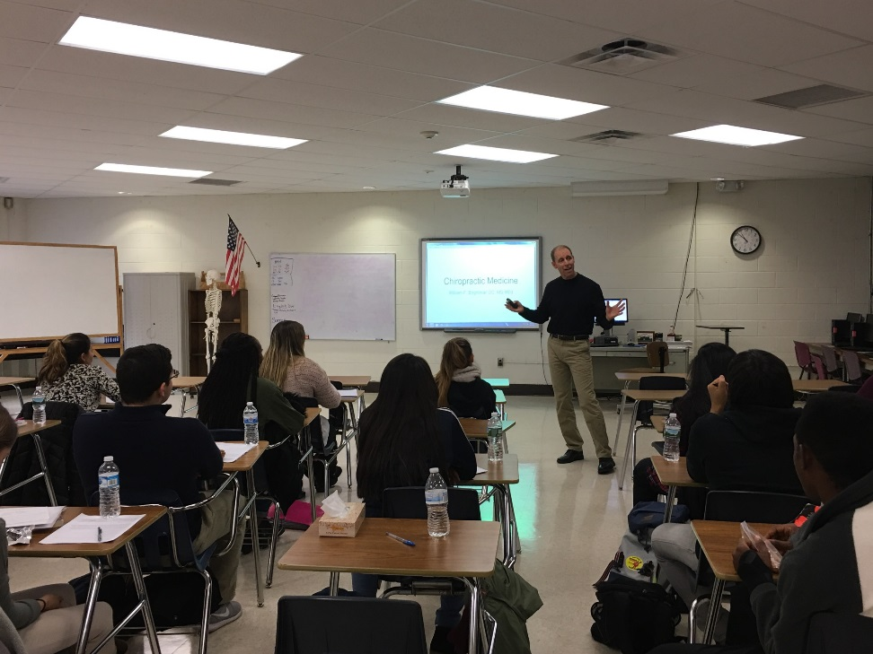
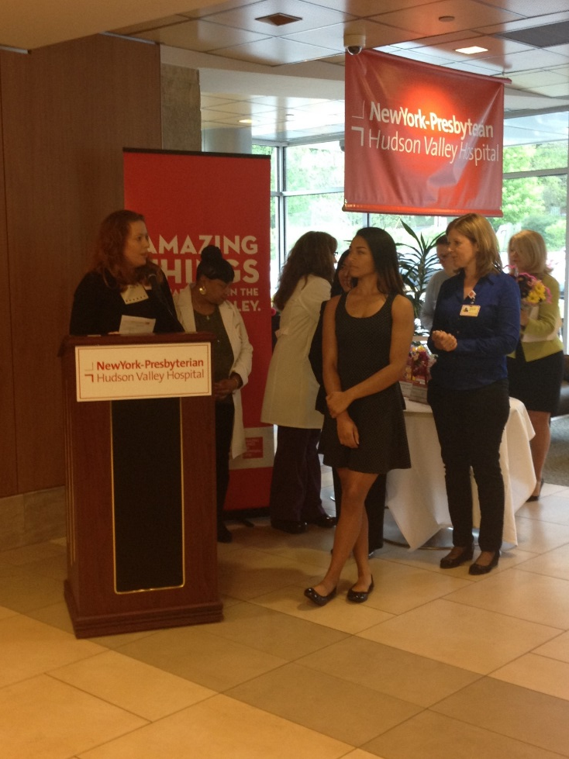
Do Something Different. Explore a career by joining new visions

Slide 20
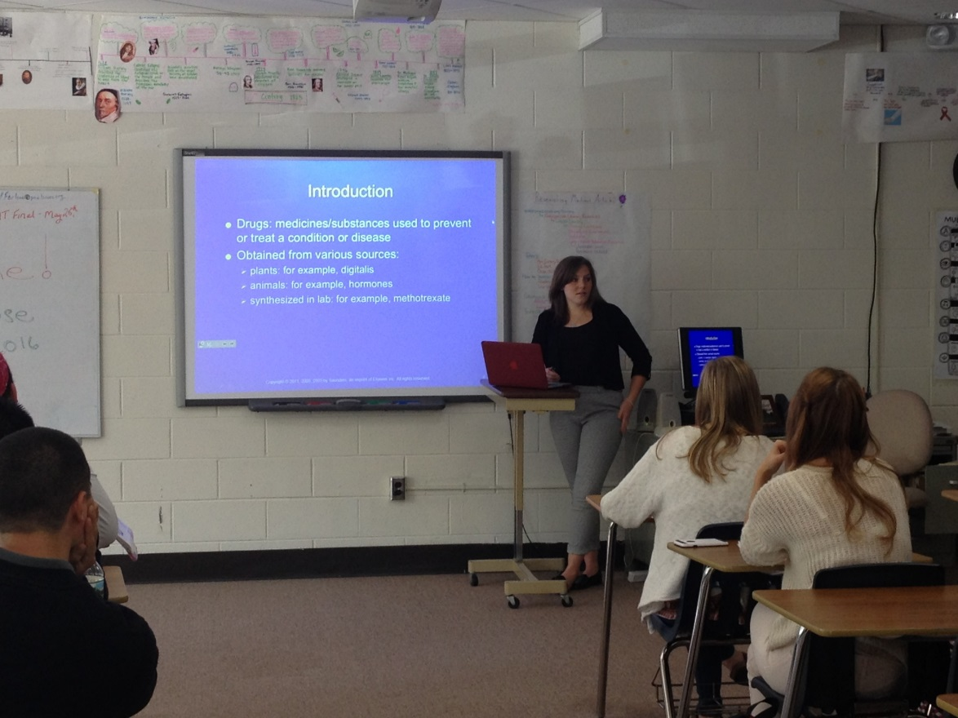
Students Who Succeed in the Program
Able to work independently
Desire to do something different senior year
Interested in hands-on learning

Slide 21
Transportation To Hospitals
Transportation is arranged by the accepted student with their home school
Some districts will transport via school bus and others do not.
It has become a year by year decision
The student or parent needs to contact the transportation department of the home school
Sometimes the guidance counselor will do it
We suggest making arrangements in June and checking on it during the summer. Confirming it in September again.
It requires the school to have someone assigned to the route and scheduling needs to be done before the new school year starts.

Slide 22
Class Expectations
Be respectful.​
Be responsible.​
Follow directions.​
Be punctual.​
Be organized.​
Be a self-starter.​
Be prepared.​
Come prepared for clinical with proper dress code

Slide 23
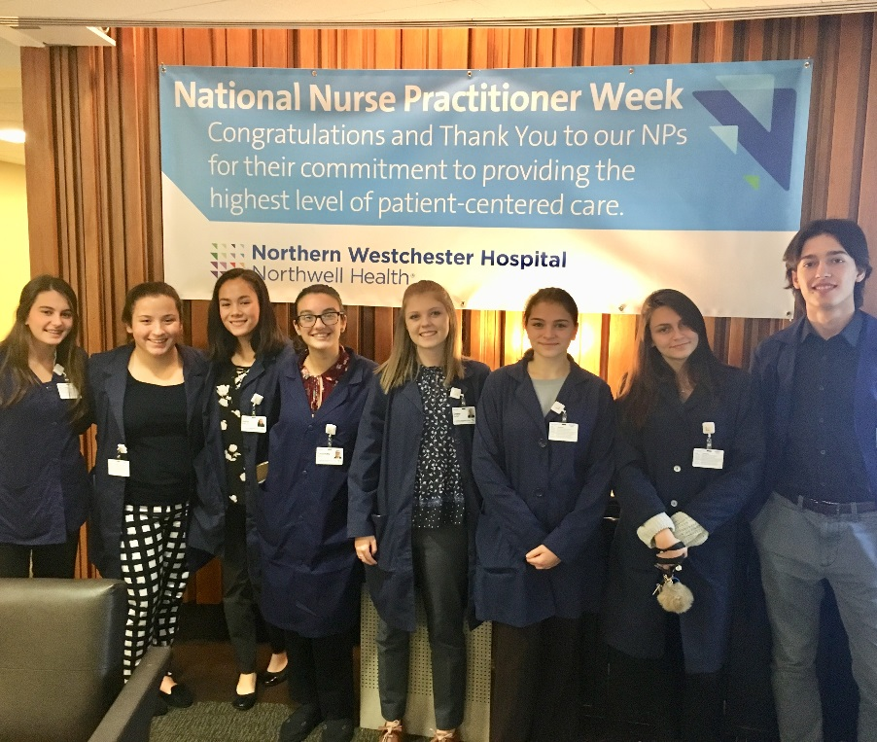
Our Students

Slide 24
How to Contact Us
You can arrange a visit to our class this year by talking to your home school counselor
Teacher emails:
Ms. Murphy cmurphy@pnwboces.org
Ms. Thibault: lthibault@pnwboces.org
Mr. Endres mendres@pnwboces.org

